Slide 1
Aspect-Based Sentiment Analysis
NLP Homework 2 July 2021 Olga Sorokoletova, 1937430

Slide 2
Overview
Models (denoted with just letters are transformer-based):
Naive
a
b
c
d
a -> b
a + b
c -> d
c + d
Given: Aspect-Based Sentiment Analysis task
Aspect Extraction
Aspect Sentiment
Aspect Extraction + Aspect Sentiment
Category Extraction
Category Evaluation
Category Extraction + Category Sentiment
Goal: Obtain the best-performing model (in terms of macro-F1)

Slide 3
Naive (just word embeddings)
Pre-processing

Slide 4
First input sentence is tokenized and each token maps to ground truth labels as follows:
1 if token ∈ gt term
0 otherwise
Pre-processing
2. Then indexed vocabulary (with <UNK> and <PAD> tokens indexed as 1 and 0) and indexed label vocabulary (with 3 elements: 2 labels and <PAD> token indexed as 2) are created:
Vocab: ['A:2', 'hearty:1', 'two:3',..., 'subwoofer:3553', 'scary:3552']
Label vocab: ['<pad>:2', '0:0', '1:1']
After 2:
[('The', 36), ('selection', 76), ('changes', 1), ('frequently', 77), ('but', 78), ('the', 9), ('basic', 79), ('dishes', 80), ('are', 81), ('always', 82), ('available', 83), ('None', 0), ('None', 0),...,('None', 0)]
[0, 1, 0, 0, 0, 0, 1, 1, 0, 0, 0, 2, 2, …, 2]
Before:
'The selection changes frequently but the basic dishes are always available.'
After 1:
['The: 0', 'selection: 1', 'changes: 0', 'frequently: 0', 'but: 0', 'the: 0', 'basic: 1', 'dishes: 1', 'are: 0', 'always: 0', 'available: 0']

Slide 5
Embeddings
Pre-processing
Two ways of creating indexed vocabulary are applied:
Based on the dataset;
Downloading GloVe 100d embeddings, so they could be further applied as pre-trained in the network layer.

Slide 6
Naive
Model

Slide 7
Model
Architecture
Hyper-parameters
Embedding(vocab size, 100)
Epochs | 100
Batch size | 128
Embedding dim | 100
Window Size | 100
Window Shift | 50
N hidden units | 128
N LSTM cells | 1
Optimizer | Adam
Learning Rate | 0.0001
Dropout Rate | 0.0
LSTM(50, 128)
Linear(128, 128)
Linear(128, 1)

Slide 8
Naive
Post-processing and Performance

Slide 9
Post-processing: collect predicted tokens to the multi-token terms
{'targets': [[[11, 29], 'wines by the glass', 'negative']],
'text': 'Not enough wines by the glass either.'}
Ground truth tokens | Input tokens | Gold labels | Predicted labels | Predicted tokens
 | Not | 0 | 0
 | enough | 0 | 0
wines | wines | 1 | 1 | wines
by | by | 1 | 1 | by
the | the | 1 | 0
glass | glass | 1 | 1 | glass
 | either | 0 | 0
Best F1: 0.67
{'wines by', 'glass'}

Slide 10
BERT-models
Pre-processing

Slide 11
Pre-processing
Interpret as a sentence-pair classification task:
<CLS> Sentence 1 <SEP> Sentence 2 <SEP> Label
Apply BERT tokenizer form pre-trained for the corresponding BERT model:
[ind(<CLS>),
indices(tokenized(sentence 1)), ind(<SEP>),
indices(tokenized(sentence 2)), ind(<SEP>),
indices(padding)]
attention mask
[1,
1,...,1, 1,
1,...,1, 1,
0, …,0]
to Embedding layers

Slide 12
Given
Pre-processing
{'categories': [['food', 'neutral']],
'targets': [[[4, 13], 'selection', 'neutral'],
[[41, 53], 'basic dishes', 'neutral']],
'text': 'The selection changes frequently but the basic dishes are always available.'}

Slide 13
Aspect Extraction
Binary classification
Pre-processing
Sentence (Sentence 1) | Aspect (Sentence 2) | Label
The selection changes frequently but the basic... | The | unrelated
The selection changes frequently but the basic... | selection | related
The selection changes frequently but the basic... | changes | unrelated
The selection changes frequently but the basic... | frequently | unrelated
The selection changes frequently but the basic... | but | unrelated
The selection changes frequently but the basic... | the | unrelated
The selection changes frequently but the basic... | basic | related
The selection changes frequently but the basic... | dishes | related
The selection changes frequently but the basic... | are | unrelated
The selection changes frequently but the basic... | always | unrelated
The selection changes frequently but the basic... | available | unrelated
The selection changes frequently but the basic... | . | unrelated

Slide 14
Given
Pre-processing
{'categories': [['food', 'neutral']],
'targets': [[[4, 13], 'selection', 'neutral'],
[[41, 53], 'basic dishes', 'neutral']],
'text': 'The selection changes frequently but the basic dishes are always available.'}

Slide 15
4-class classification
{positive, negative, neutral, conflict}
Aspect Sentiment
ground truth terms
Pre-processing
Sentence (Sentence 1) | Aspect (Sentence 2) | Label
The selection changes frequently but the basic... | selection | neutral
The selection changes frequently but the basic... | basic dishes | neutral

Slide 16
Given
Pre-processing
{'categories': [['food', 'neutral']],
'targets': [[[4, 13], 'selection', 'neutral'],
[[41, 53], 'basic dishes', 'neutral']],
'text': 'The selection changes frequently but the basic dishes are always available.'}

Slide 17
Binary classification
Category Extraction
fixed 5 for each Sentence 1
Pre-processing
Sentence (Sentence 1) | Category (Sentence 2) | Label
The selection changes frequently but the basic... | food | related
The selection changes frequently but the basic... | service | unrelated
The selection changes frequently but the basic... | price | unrelated
The selection changes frequently but the basic... | ambience | unrelated
The selection changes frequently but the basic... | anecdotes/miscellaneous | unrelated

Slide 18
Given
Pre-processing
{'categories': [['food', 'neutral']],
'targets': [[[4, 13], 'selection', 'neutral'],
[[41, 53], 'basic dishes', 'neutral']],
'text': 'The selection changes frequently but the basic dishes are always available.'}

Slide 19
4-class classification
{positive, negative, neutral, conflict}
Category Sentiment
ground truth categories
Pre-processing
Sentence (Sentence 1) | Category (Sentence 2) | Label
The selection changes frequently but the basic... | food | neutral

Slide 20
Given
Pre-processing
{'categories': [['food', 'neutral']],
'targets': [[[4, 13], 'selection', 'neutral'],
[[41, 53], 'basic dishes', 'neutral']],
'text': 'The selection changes frequently but the basic dishes are always available.'}

Slide 21
Aspect Extraction +
Aspect Sentiment
Pre-processing
5-class classification
{none, positive, negative, neutral, conflict}
Sentence (Sentence 1) | Aspect (Sentence 2) | Label
The selection changes frequently but the basic... | The | none
The selection changes frequently but the basic... | selection | neutral
The selection changes frequently but the basic... | changes | none
The selection changes frequently but the basic... | frequently | none
The selection changes frequently but the basic... | but | none
The selection changes frequently but the basic... | the | none
The selection changes frequently but the basic... | basic | neutral
The selection changes frequently but the basic... | dishes | neutral
The selection changes frequently but the basic... | are | none
... | ... | ...

Slide 22
Aspect Extraction ->
Aspect Sentiment
Binary classification
predictions
4-class classification
{positive, negative, neutral, conflict}
predicted terms
Pre-processing
Sentence (Sentence 1) | Aspect (Sentence 2) | Label
The selection changes frequently but the basic... | The | unrelated
The selection changes frequently but the basic... | selection | related
... | ... | ...
Sentence (Sentence 1) | Aspect (Sentence 2) | Label
The selection changes frequently but the basic... |  | neutral
... | ... | ...

Slide 23
Given
Pre-processing
{'categories': [['food', 'neutral']],
'targets': [[[4, 13], 'selection', 'neutral'],
[[41, 53], 'basic dishes', 'neutral']],
'text': 'The selection changes frequently but the basic dishes are always available.'}

Slide 24
Category Extraction +
Category Sentiment
fixed 5 for each Sentence 1
Pre-processing
5-class classification
{none, positive, negative, neutral, conflict}
Sentence (Sentence 1) | Category (Sentence 2) | Label
The selection changes frequently but the basic... | food | neutral
The selection changes frequently but the basic... | service | none
The selection changes frequently but the basic... | price | none
The selection changes frequently but the basic... | ambience | none
The selection changes frequently but the basic... | anecdotes/miscellaneous | none

Slide 25
Category Extraction ->
Category Sentiment
Binary classification
predictions
4-class classification
{positive, negative, neutral, conflict}
predicted categories
Pre-processing
Sentence (Sentence 1) | Aspect (Sentence 2) | Label
The selection changes frequently but the basic... | food | unrelated
The selection changes frequently but the basic... | service | related
... | ... | ...
Sentence (Sentence 1) | Aspect (Sentence 2) | Label
The selection changes frequently but the basic... |  | neutral
... | ... | ...

Slide 26
BERT-models
Models

Slide 27
a
b
a+b
c
d
c+d
Models
Model | Epochs | Batch Size | Learning Rate
Small BERT | 10 | 24 | 0.00002
BERT | 4 | 16 | 0.00002
Distil BERT | 4 | 24 | 0.00002
Large BERT | 4 | 24 | 0.00002

Slide 28
BERT-models
Performances

Slide 29
Performances: Naive vs BERT for Aspect Extraction and Choose the best BERT
Task: Aspect Extraction
Dataset: Restaurants
Task: Aspect Extraction
Dataset: Restaurants
Dataset: Restaurants
Model | Best F1
Small BERT | 79
BERT | 81
Distil BERT | 83
Large BERT | 83
Model | Best F1
Naive | 67
Distil BERT | 83
Task | Distil BERT | Large BERT
b | 55 | 60
a + b | 44 | 48
c + d | 48 | 56
Transformer based architecture is preferable
Large BERT is preferable
Distil BERT is preferable

Slide 30
Performances: Choose best model for joined and separate tasks, merge datasets
Dataset: Restaurants
Dataset: Restaurants
Task: Aspect Sentiment
Task | As is | From Combined
a | 83 | 82
b | 60 | 50
c | 82 | 82
d | 64 | 55
Task | -> | +
ab | 48 | 40
cd | 50 | 56
Dataset | Best F1
Restaurant | 60
Laptops | 54
Mixed | 59
For Aspect Extraction + Aspect Sentiment a -> b performs better than a + b
For Category Extraction + Category Sentiment c + d performs better than c -> d
Mixed dataset can be approximated by Restaurants
Laptops are a bit harder than Restaurants
Separately implemented models perform better than their estimations from a + b and c + d

Slide 31
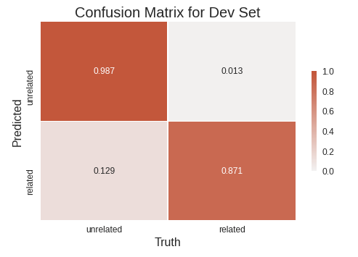
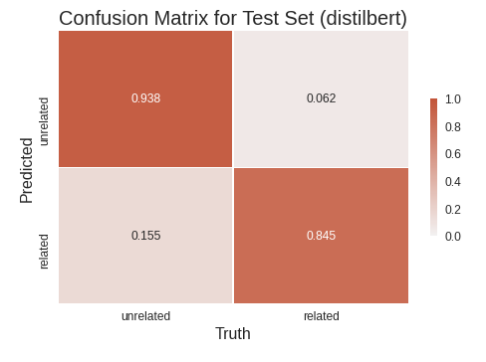
Performances: Confusion matrices for Extractions
For tokens!
Task: Aspect Extraction
Dataset: Mixed
Task: Category Extraction
Dataset: Restaurants

Slide 32
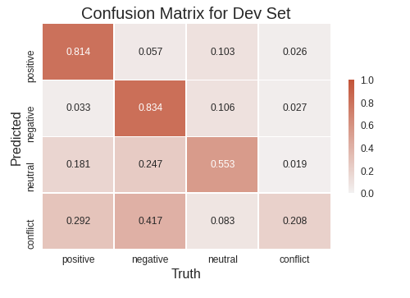
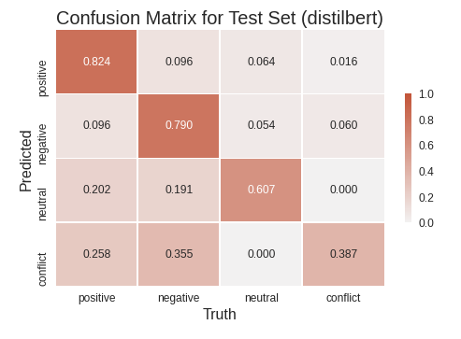
Performances: Confusion matrices for Sentiments
Task: Aspect Sentiment
Dataset: Mixed
Task: Category Sentiment
Dataset: Restaurants

Slide 33
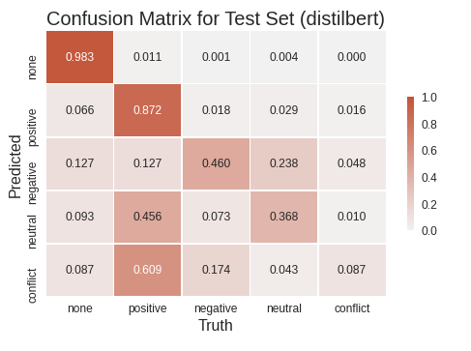
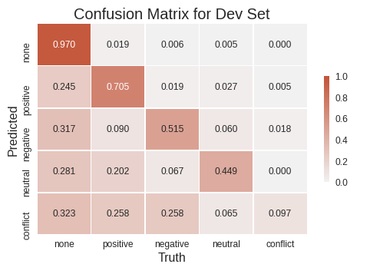
Performances: Confusion matrices for Combinations
For tokens!
Task: a + b
Dataset: Mixed
Task: c + d
Dataset: Restaurants

Slide 34
Conclusion

Slide 35
Transformers are powerful instrument in approaching Aspect-Based Sentiment Analysis;
Sentence-pair classification interpretation of a task is appropriate for use of pre-trained BERT models;
Work on aspects could be improved through the modification of the decoding approach;
Work on categories could be improved through the conceptual modifications;
Precise fine-tuning should be under focus;
For sentiment analysis part conflict class is the hardest for recognition.

